Slide 1
VOICE ASSISTANT FOR LINUX
GOKUL 2015115013
MAGESH 2015115026
DAVID 2015115070

Slide 2
ABSTRACT
An AI assistant for a computer is an interface between the computer and ourselves that can comprehend humans without the rigid rules of programming. Unlike other interfaces, this will allow us to interact with the system as humans interact with themselves.
Our project concentrates on developing an AI assistant with Linux as a first-class citizen. The AI assistant can be interacted with using your voice.

Slide 3
FEATURES
Fully supports the Linux platform (All distros are supported).
Extensible design — can add extra modules.
Integration with APIs to provide services such as currency conversion, reminders, weather forecast, and more.
Uses Google TTS to provide replies that sound natural.
Uses NLP techniques to answer queries based on context.
All APIs used are completely free of charge.
Can be easily invoked from any terminal using your favourite shell.

Slide 4

EXAMPLE USE CASE: SMALL TALK
Invocation:
“How are you?”

Slide 5

EXAMPLE USE CASE: REMINDERS
Equivalent invocations:
“Remind me tomorrow at 6AM to call Gokul”
“Remind me to call Gokul tomorrow morning”
The values from the JSON object are used to create a Google Calendars reminder.

Slide 6

EXAMPLE USE CASE: WEATHER FORECAST
Equivalent invocations:
“What’s the weather in Tokyo”
“Weather in Tokyo today”

Slide 7
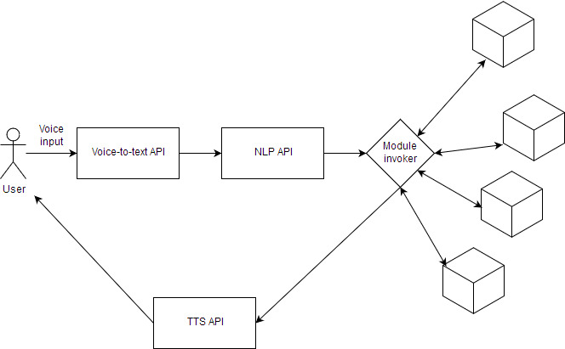
FLOW DIAGRAM
DIALOGFLOW API

Slide 8
References
https://cloud.google.com/natural-language/
https://github.com/Uberi/speech_recognition
https://cloud.google.com/appengine/docs/standard/python/mail/
https://developers.google.com/google-apps/calendar/quickstart/python
https://www.crummy.com/software/BeautifulSoup/bs4/doc/
https://www.linux.com/learn/understanding-and-using-systemd
https://www.coretechnologies.com/products/AlwaysUp/Apps/RunPythonScriptAsAService.html
https://dialogflow.com/docs/reference/agent-json-fields
https://github.com/pndurette/gTTS

